Slide 1
Conceptualising social complexity and inequality in urban networks.
TAG 2019 – S22: Archaeology of Inequality – Themes, Debates, Methodologies
Dries Daems
University of Leuven
dries.daems@kuleuven.be
@DriesDaems

Slide 2
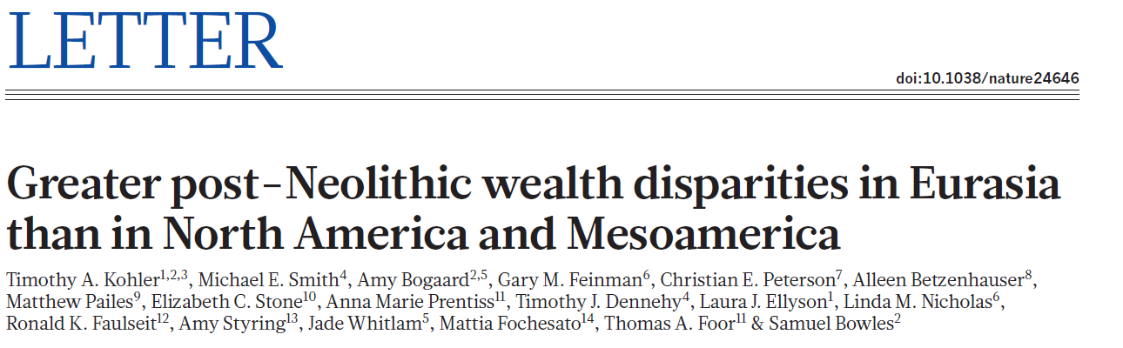
1. Small differences in initial conditions
2. Positive feedback loops
3. Pathways of development
Notes:
Availability of large mammals that could be domesticated
Multiplier for human labour → allowed more profitable agricultural extensification → exacerbation of initial socio-economic inequality (richer households better able to maintain animals)
Higher production → increased agricultural surpluses → higher maximal attainable inequality → extended land ownership → mounted warrior elite and expanding polities

Slide 3
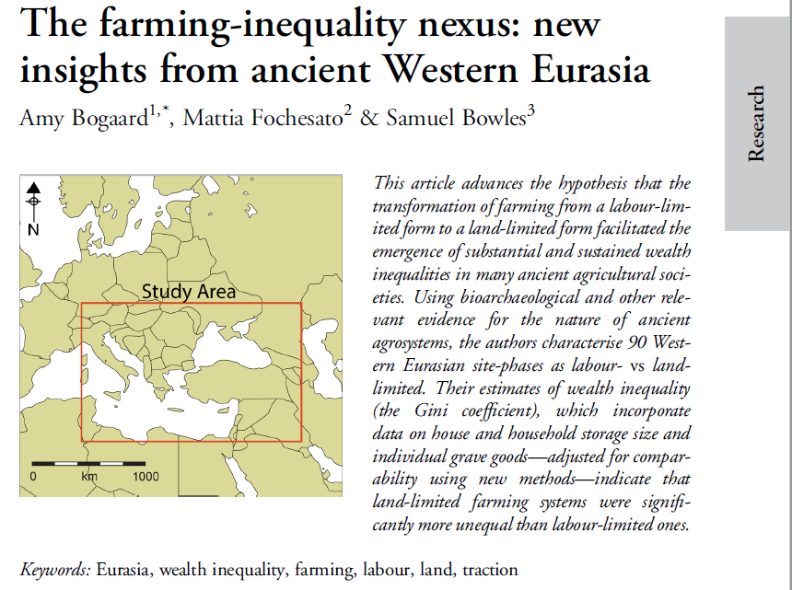
Labour
Ownership
Inheritance
Notes:
Clumped resources logic (<behavioural ecology)
disparities in land and other forms of material wealth could far exceed differences in productive human capacities
These inequalities, including the results of shocks, are transmitted from one generation to the next to a far greater extent than is the case for human capacities
→ Cumulative wealth and inequality increase

Slide 4
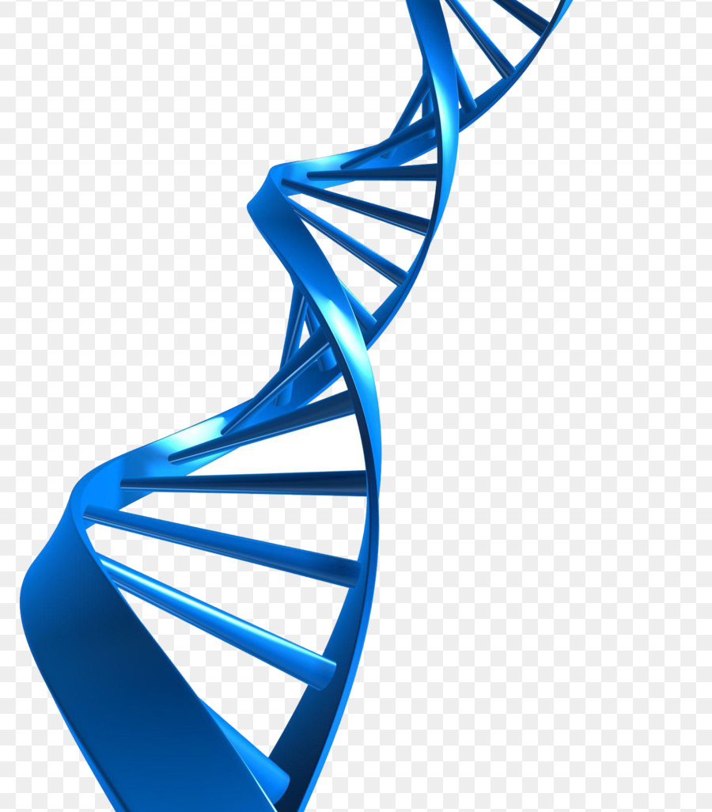
Social complexity and inequality
(Implicit) assumption of correspondence between complexity and inequality
Different forms of inequality
Social, economic, political,…
Different scales of inequality
Individual, groups, societal,…
Different mechanisms of inequality
Status, division of labour, inheritance,…
Notes:
But inequality is a complex phenomenon consisting of different forms, scales and mechanisms
It is therefore worthwhile to consider inequality from the perspective of complex systems dynamics

Slide 5
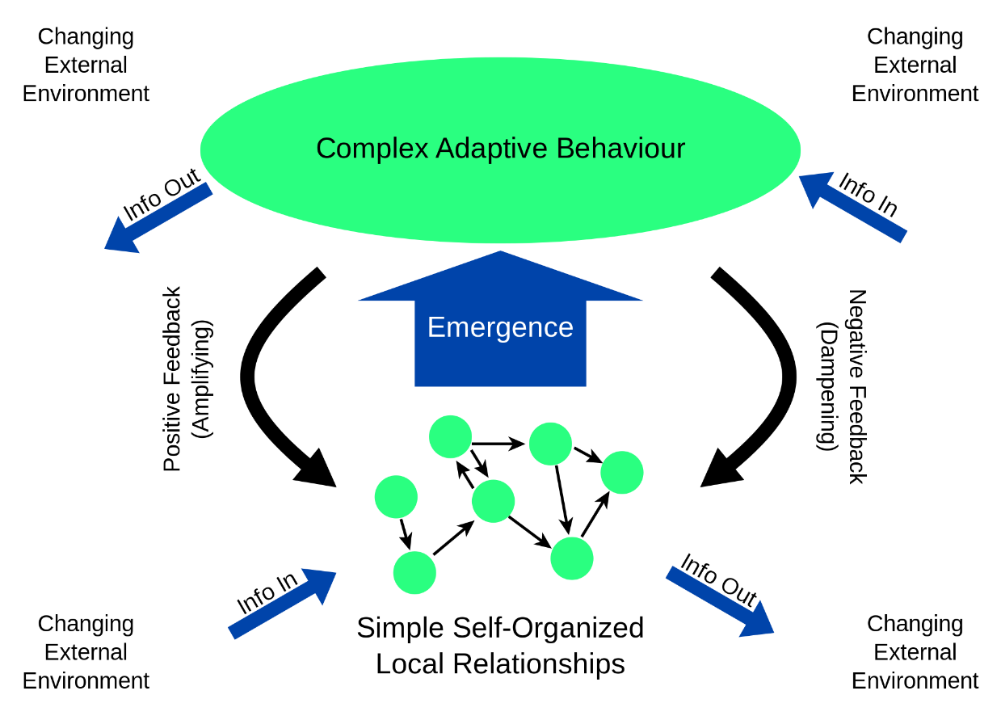
Social complexity and complex systems
Social organization/institutions
2
1
Material expression
Social practices
Social action/interaction
Temporal, spatial and social structuration
Archaeological reflection: Material expression of social interactions, practices and institutions
Notes:
Fundamental unit of complexity = social interactions between people
Micro-macro transition: Emergent social organization out of social interactions → structuration
One of the crucial processes in complex systems = information-processing and decision-making strategies

Slide 6
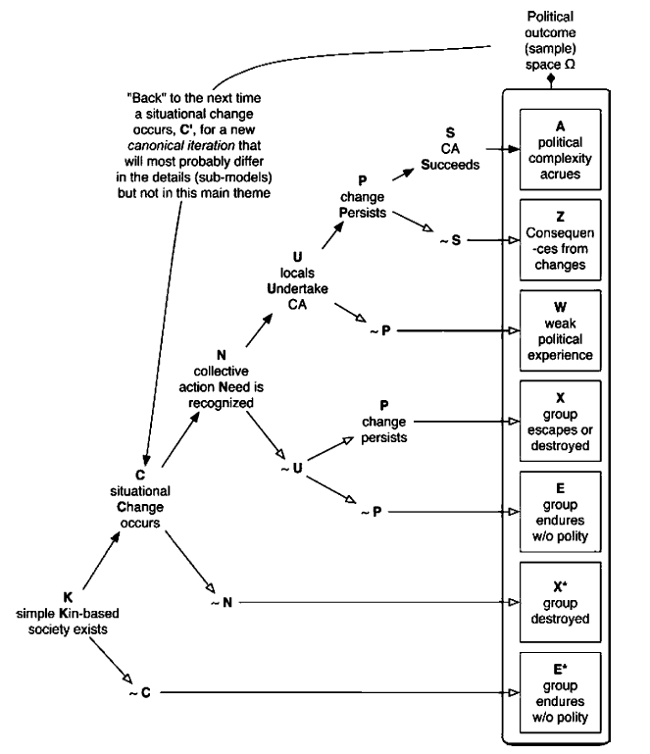
Social complexity trajectories
How did social complexity develop through decision-making strategies?
Dual loop of signal detection, information-processing, and problem-solving strategies:
‘Fast’ process of decision-making processes
‘Slow’ process of socio-political complexity
Cioffi-Revilla 2005
Cioffi-Revilla (2005) A Canonical Theory of Origins and Development of Social Complexity
Notes:
How to link social complexity to information-processing and decision-making strategies?? → Framework of Cioffi-Revilla

Slide 7
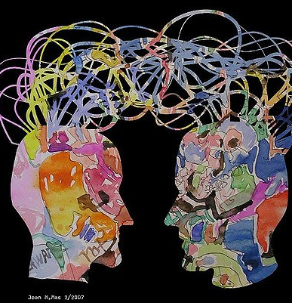
Complexity and inequality in cities: social entropy
Overload in high-information environments
Uncertainty in transition from individual to collective systems of interaction
Selection of interaction
Influencing probabilities of interaction
Development of inequality inevitable
What information selected and why?
Purpose? Or emergent coordination of actions between agents with differing goals?
Credit to artist Joan M. Mas
Netto, V., Meirelles, J., & Ribeiro, F. (2017) Social Interaction and the City: The Effect of Space on the Reduction of Entropy. Complexity.
Netto, V. et al. (2018) Cities, from Information to Interaction. Entropy, 20(11), 834.
Notes:
So we have a general framework of information processing and complexity, but how does it work?
Information overload is a general feature of human societies when moving from individual to group level (ex. Group size limits)
→ In principle, everyone can interact with everyone else in a group; in practice this is not possible
Information selection is an inherent feature of societal group formation by defining which interaction possibilities are actualized
The interesting questions then become: which interaction possibilities are favoured and why?
Lots of work has been done on these questions, for example from perspective of Marxist Archaeology. But also bottom-up emergence of coordination out of disparate actions from agents pursuing different goals, mediated by an information space
I will not consider Marxist work here, but will instead focus on cities and urban networks as examples of such coordination patterns

Slide 8
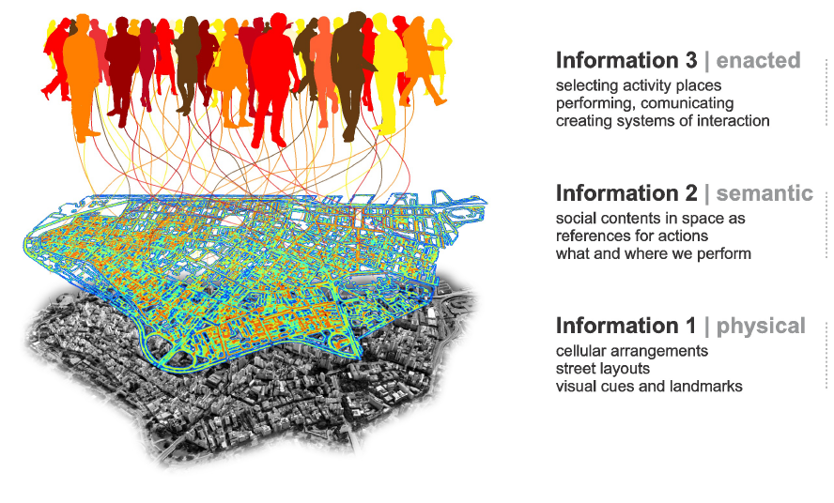
Complexity and inequality in cities: social structuration
Recurrent needs and goals requiring recurrent actions creates order
Structuration = increasing complexity & reduction of entropy
Use of space and material environment
Create difference
Shape interaction possibilities
Netto, V., Meirelles, J., & Ribeiro, F. (2017) Social Interaction and the City: The Effect of Space on the Reduction of Entropy. Complexity.
Netto, V. et al. (2018) Cities, from Information to Interaction. Entropy, 20(11), 834.
Notes:
Recurrence → Structuration inherently results in some forms of inequality by iteratively favouring certain interaction possibilities over others
(iteration ~Cioffi-Revilla!)

Slide 9
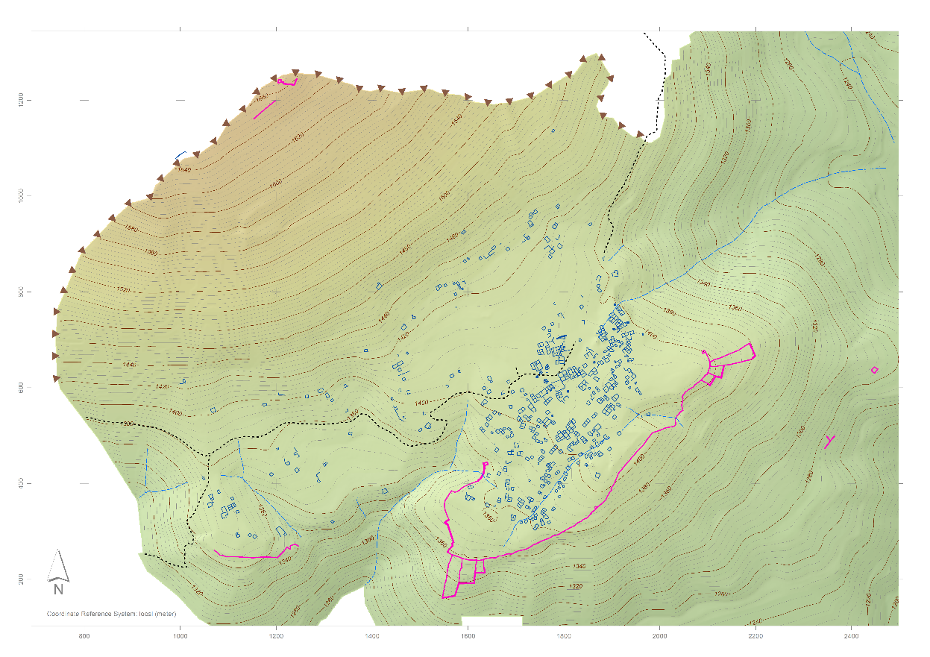
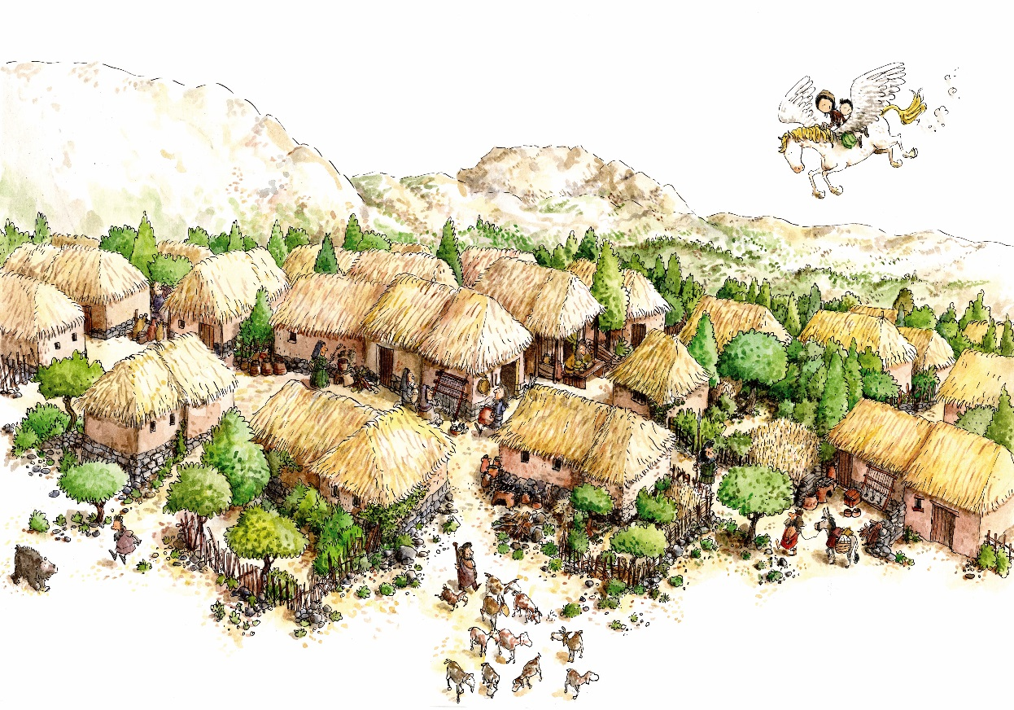
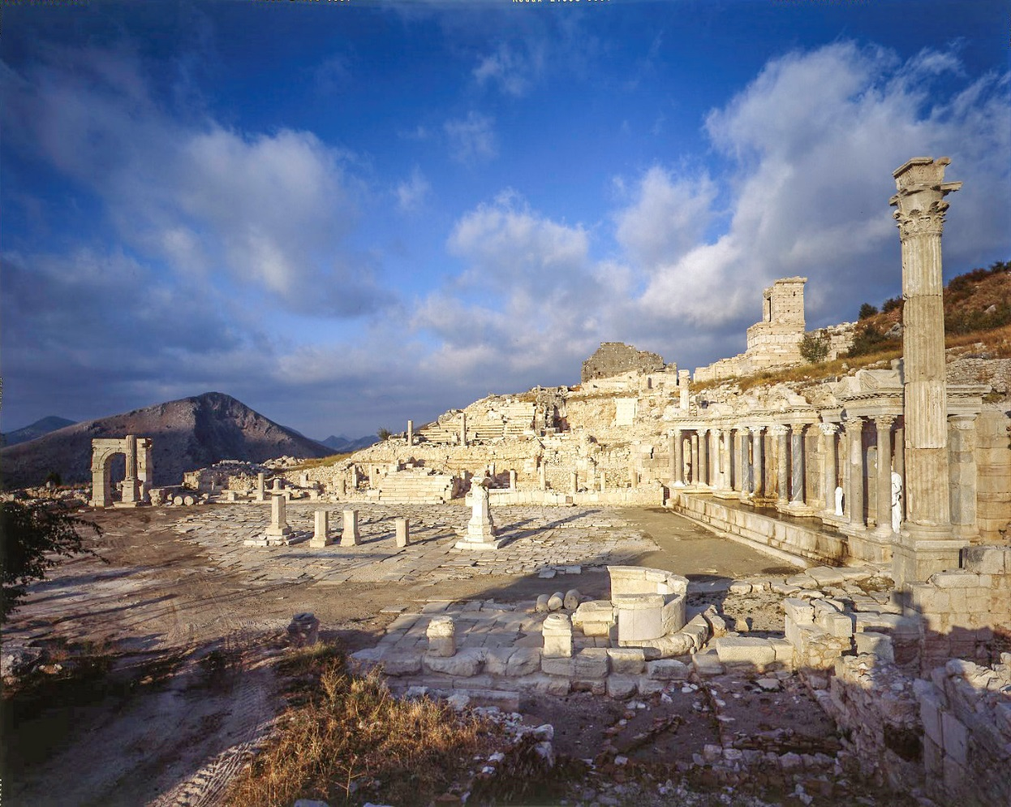
Cities as mechanisms of structuration
Düzen Tepe
Sagalassos
Notes:
Settlements as pockets of social interaction and information exchange → cities as mechanisms of structuration

Slide 10
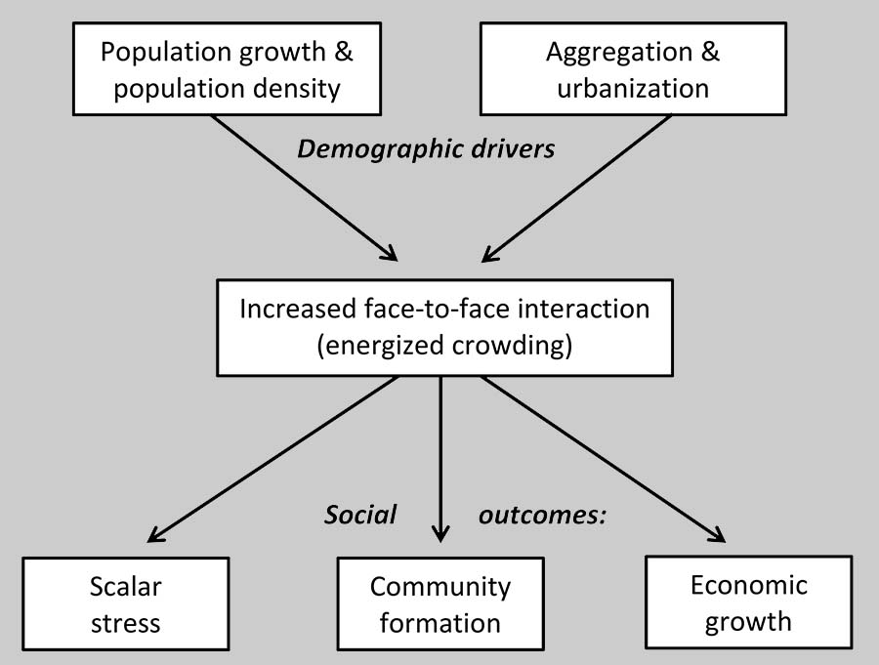
Cities as information amplifiers
Cities as pockets of social interaction and information exchange
Positive and negative effects of growing communities and increasing interactions
Intra-community (settlement)
Inter-community (settlement pattern)
Smith 2019
Smith (2019) Energized Crowding and the Generative Role of Settlement Aggregation and Urbanization; In Gyucha (ed.) Coming Together.
Bettencourt (2013) The Origins of Scaling in Cities
Notes:
Selective properties of cities allow information to be structured and communities to grow!
But also outcomes on inter-community level → fission and fusion + central place formation
1. Scalar stress: decreasing consensus in decision making processes and decrease of effectiveness in group performance (Johnson 1982)
2. Community formation: Increasing group sizes possible due to the integration of increasingly more levels of organization

Slide 11
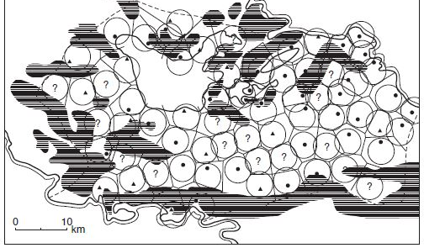
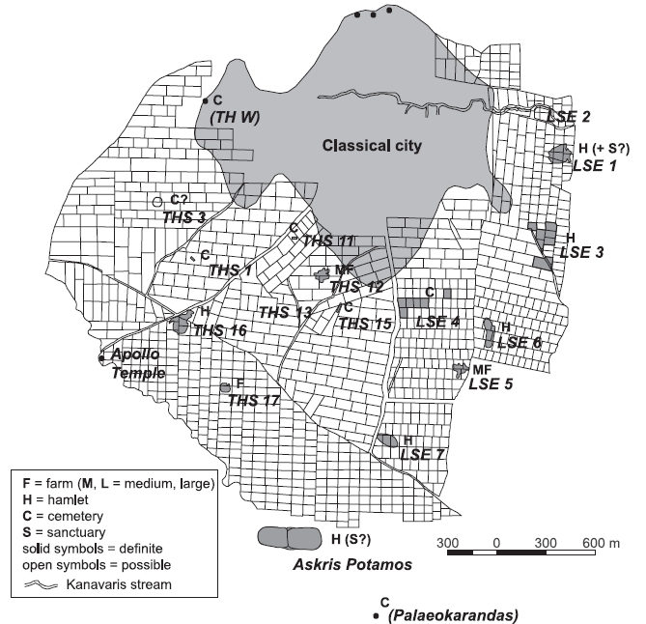
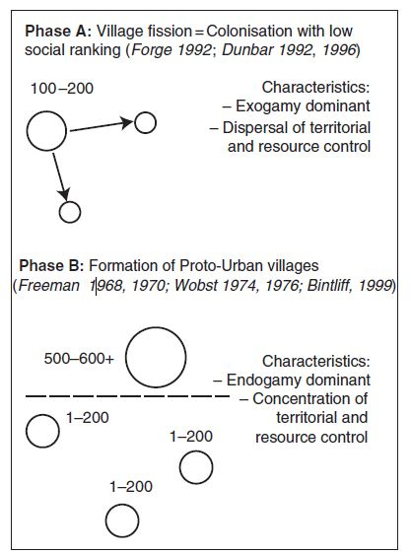
Cities as information amplifiers: Central place formation
Settlement patterns as material and informational expressions of information systems
Manifestation of inequality on an inter-community level
Urban formation:
New forms of social organization, socio-political structures and institutions
Development of social, political and economic elite
Territorialisation
New forms of material culture and monumental architecture
Bintliff et al. (2007) Emergent complexity in settlement systems and urban transformations.
Bintliff (1994) Territorial behaviour and the natural history of the Greek polis. Stuttgarter Kolloq. Hist. Geogr. D. Altertums

Slide 12
Conclusion: Model of social complexity trajectories
Community formation
Central place formation
Population aggregation
Energized crowding
Community fusion
Scalar stress
Community fission
Intra-community dynamics
Inter-community dynamics
Daems, D. (Forthcoming) Social Complexity and Complex Systems in Archaeology. Routledge (to be published in 2020).

Slide 13
Thank you for your attention! Dries Daems University of Leuven dries.daems@kuleuven.be @DriesDaems

Slide 14
Argument:
Wealth disparities generally increased with the domestication of plants and animals and with increased socio-political scale, using Gini coefficients computed over the single consistent proxy of house-size distributions. But: unexpected differences in the responses of societies to these factors in North America and Mesoamerica, and in Eurasia, due to the greater availability of large mammals that could be domesticated, because they allowed more profitable agricultural extensification, and also eventually led to the development of a mounted warrior elite able to expand polities (political units that cohere via identity, ability to mobilize resources, or governance) to sizes that were not possible in North America and Mesoamerica
Different pathways of development starting from different initial conditions + positive feedback loops
Availability of large animals for domestication → multiplier for human labour → agricultural extensification beyond needs of households → exacerbation of initial socio-economic inequality (richer households better able to maintain drat animals) → 1) higher production + income from renting out animals; 2) increased agricultural surpluses → 1) higher maximal attainable inequality; 2) extended land ownership; 3) mounted warrior elite → larger political-military expansion → state formation
On a micro-scale: Saga vs. Düzen!

Slide 15
Transformation of farming from a labour-limited form to a land-limited form facilitated the emergence of substantial and sustained wealth inequalities in many ancient agricultural societies.
Clumped-resources logic to demonstrate how a transformation of farming could support the novel emergence of elevated levels of inequality
different possibilities for accumulating, storing and transmitting wealth across generations
By substantially increasing the productivity of land and animals, food production made land and other concentrated, defensible forms of wealth far more common than the rich resource concentrations upon which hunter-gatherer wealth inequality was sometimes based
Notes:
Our proposed explanation of the emergence of persistent, substantial wealth inequality is a variant of a hypothesis from behavioural ecology, which states that clumped, as opposed to dispersed, resources are the basis of dominance hierarchies in non-human animals
disparities in land and other forms of material wealth could far exceed differences in productive human capacities
These inequalities, including the results of shocks, are transmitted from one generation to the next to a far greater extent than is the case for human capacities
→ Cumulative wealth and inequality increase

Slide 16
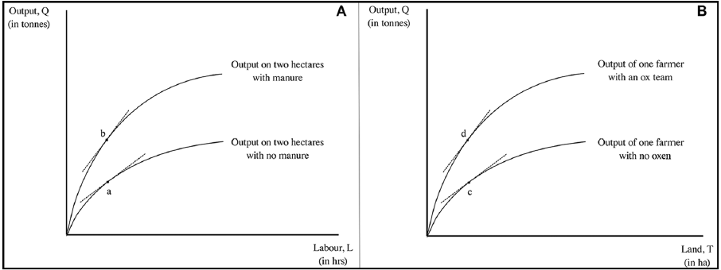
Diminishing returns to investment (labour); BUT: innovation inducing leaps of productivity
Manure = land-augmenting; animal traction = labour-augmenting
Negative and positive feedback loops!

Slide 17
Mechanisms of complexity
Diversification
Connectivity
Specialization

Slide 18
Complexity in social systems
Fundamental unit of complexity = social interactions between people
Micro-macro transition: Emergent social organization out of social interactions
Focus on information-processing and decision-making strategies
Notes:
First, a general overview of complex (social) systems
- Fundamental unit of complexity = social interactions between people
Micro-macro transition: Emergent social organization out of social interactions
Focus on information-processing and decision-making strategies

Slide 19
How does this work?
Social entropy in information systems and inequality?
Entropy (cfr. Boltzmann) characterizes each macroscopic state in terms of the number of (microscopic) ways of achieving this state
Structuration = increasing organizational complexity & reduction of entropy
Inequality develops!
THOUGHT: Model presented here is built on social interactions, presupposing (or at least implying) to a certain degree the exchange of information between equal partners → what about inequality cfr. above in exchange partners?
Notes:
From general conceptual in last slide towards operationalisation in cities and urban networks

Slide 20
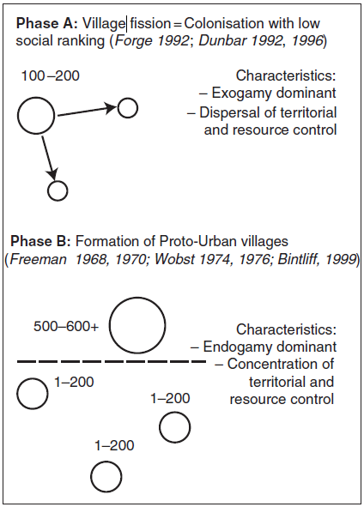
Structuration: complexity thresholds
Types of community organisation with population thresholds
Villages: 100-200 people
Proto-urban (corporate communities): 500-600 people
Urban: > 1500 people
HOW TO OPERATIONALISE?
Bintliff et al. (2007) Emergent complexity in settlement systems and urban transformations.

